Slide 1
Excel Pivot Tables
Pivot tables are powerful tools for data analysis. They summarize large datasets, revealing insights quickly.
By NIVED SUDHINDRAN

Slide 2
What are Pivot Tables?
Data Summarization - Pivot tables summarize data from large spreadsheets.
Interactive Exploration - Easily explore data by dragging and dropping fields.
Aggregation - Calculate sums, averages, counts, and more.

Slide 3
Benefits of Pivot Tables
Time Savings - Quickly analyze large datasets.
Improved Insights - Uncover trends and patterns easily.
Better Decisions - Data-driven decisions are more effective.

Slide 4
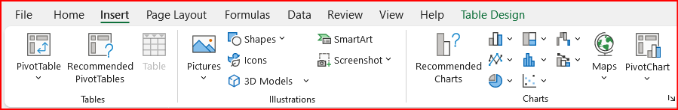
Steps for building a Pivot Table
Select Data - Highlight your data range.
Insert PivotTable - Choose the PivotTable option.
Drag Fields - Drag fields to rows, columns, values.

Slide 5
Slicers in PivotTable
Slicers are buttons that filter data in a PivotTable.
Slicers can be used to filter data quickly and indicate the current filtering state

Slide 6
THANK YOU

